Slide 1


Binu Rohit Dara - Praneetha Kanna -11725393 Hima Bindu Uppu - 11719993

Slide 2

Predicting scholarship awards for students using academic factors

Slide 3

Introduction
The student’s dataset consists of information about each student and their academic standing, financial need and demographic information. It includes characteristics like gender, total scores in three subjects (referred to as Sub-1, Sub-2 and Sub-3) percentage and grades. This dataset offers a chance to investigate a number of variables affecting students financial and academic circumstances. In order to create focused interventions and support systems, educators, legislators, and other stakeholders in education sector, they must need a thorough understanding of these factors. Through the analysis of this dataset, potential areas for intervention and improvement can be highlighted by identifying patterns, trends and correlation between various attributes.

Slide 4
Dataset
The dataset consists of 2000 rows along with 12 attributes.
Scholarship Award status: The status is to determine whether the student is awarded the scholarship or not. It is binary, where recipients are denoted by ‘1’ and non-recipients ‘0’.
Subject scores: Three subject scores are included in the dataset. these results could act as key indicator of a students eligibility for scholarships and could show how proficient are they in particular academic subjects.
Gender: the dataset also consists of gender as demographic variable. It might have an effect on scholarship decisions directly depending on how it correlates with other variables.
ID and email: These fields act as identifiers and might not be directly related to the analysis.
Financial need: This field indicates if participant has requested financial assistance or not. It offers important note on students financial situations, which could have an impact on how students respond or perform in study.
Grades: shows the participants grade according to their performance. Grades are categorical signifying the level of proficiency in the subject.
Percentage: Based on the participants overall scores and grades , it mostly represents the participants percent. It gives a common way to measure students performance.

Slide 5


Methodology
Data Quality and Pre-processing
Exploratory data analysis
Model selection and Training
Results and Interpretation

Slide 6
Data quality and Pre-processing
Prior to proceeding with analysis, we have certaining the dataset quality. We have searched for irregularities, missing data and consistency problems that might effect the findings accuracy. Renaming the specific columns in data frame to new names specified in the column directory. Using the label-encoder from Scikit-learn to encode the categorical variables (gender and financial need) into numerical labels as machine learning algorithms need numerical inputs in most of the cases and also transforming categorical grades into numerical representations as to prepare data for further modelling and analysis.

Slide 7
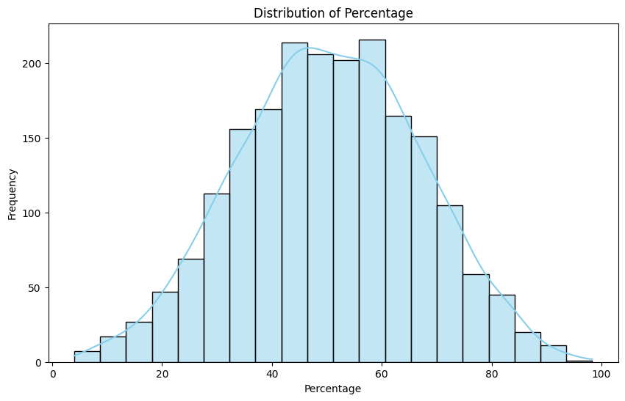
Exploratory Data Analysis
Distribution of Percentage Variable with Histogram and KDE
Results: This graph shows the distribution of the students' percentage variables. There may be two different student groups, as the histogram demonstrates that the percentage variable has a bimodal distribution with two peaks. The KDE aids in comprehending the distribution and overall form of the percentage data distribution.
Insights: The bimodal distribution implies that there are two student groups, and these groups might be distinguished from one another by certain factors.

Slide 8
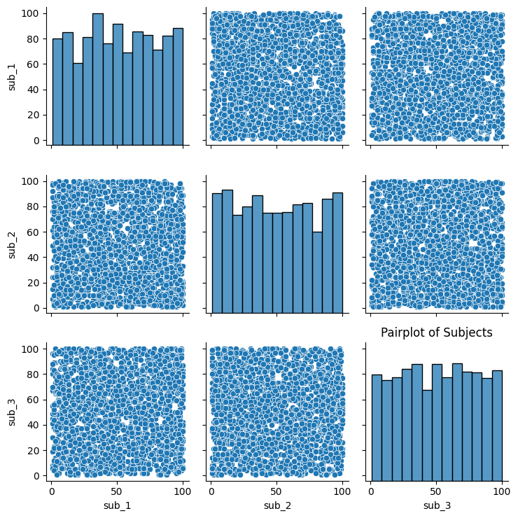
Pairwise Associations Between Academic Subject Scores
Results: This graph uses scatter plots and histograms to show how students' academic subject scores relate to one another. While the histograms display the distribution of each academic subject score, the scatter plots aid in the identification of any linear or non-linear correlations or patterns between the variables.
Insights: The scatter plots show that there is a significant distributional variance and a positive correlation between academic subject scores.

Slide 9
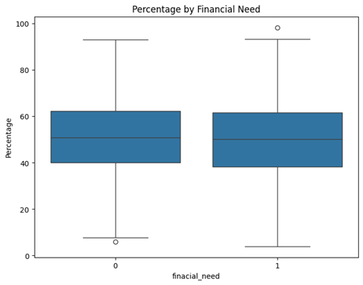
Percentage by Financial need
Results: This graph uses box plots to illustrate the relationship between the percentage variable and financial need. The graph shows the distribution of percentage values within each of the two financial need categories, (0 and 1).
Insights: According to the graph, students who require financial assistance typically have lower percentage values than students who do not.

Slide 10
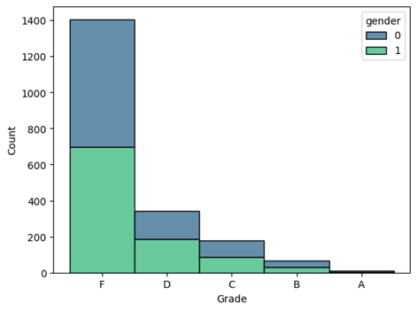
Gender Distribution Across Grade Levels
Results: Using stacked histograms, this graph displays the gender distribution of students across various grade levels. The frequency of male and female students in each grade level is displayed in the histograms.
Insights: In every grade level, the gender distribution shows that there are more male students than female students.

Slide 11
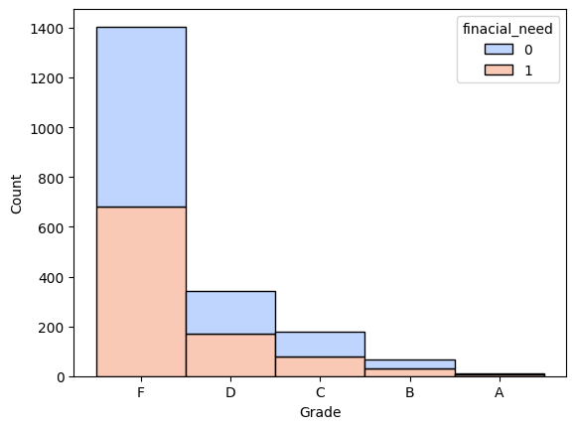
Distribution of Students by Financial Need Across Grade Levels
Results: Using stacked histograms, this graph displays the distribution of students by financial need status across various grade levels.
Insights: In each grade level the stacked histograms demonstrate that there are less students in need of financial assistance than there are students in good financial standing. Additionally, the proportions of the financial need categories are roughly the same for all grade levels.

Slide 12
Model – Logistic regression
Logistic regression is a popular statistical technique for tasks involving binary classification. It can be used to predict binary outcomes because it models the likelihood that a given input belongs to a specific class using a logistic function. When examining a student's eligibility for financial aid academic standing and individual traits can be used as input features in logistic regression to predict a participant's likelihood of receiving aid. Logistic regression helps identify people who might benefit from more help by modeling the likelihood of receiving financial aid based on these factors. This helps with resource allocation and decision-making regarding support services.

Slide 13
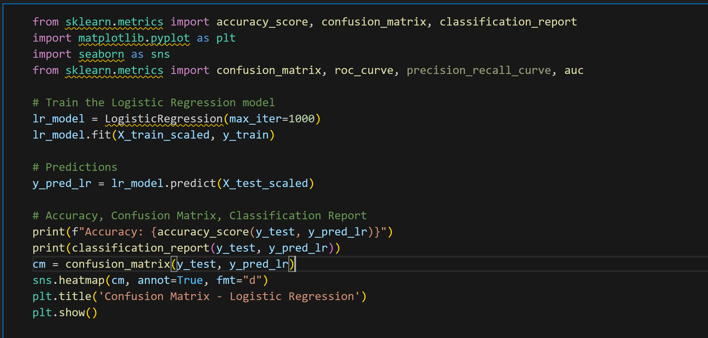
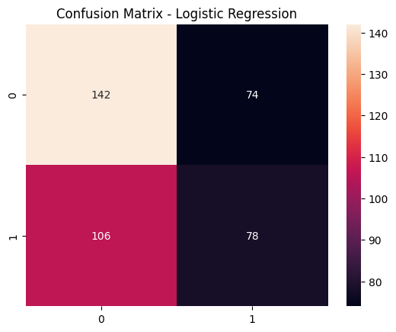
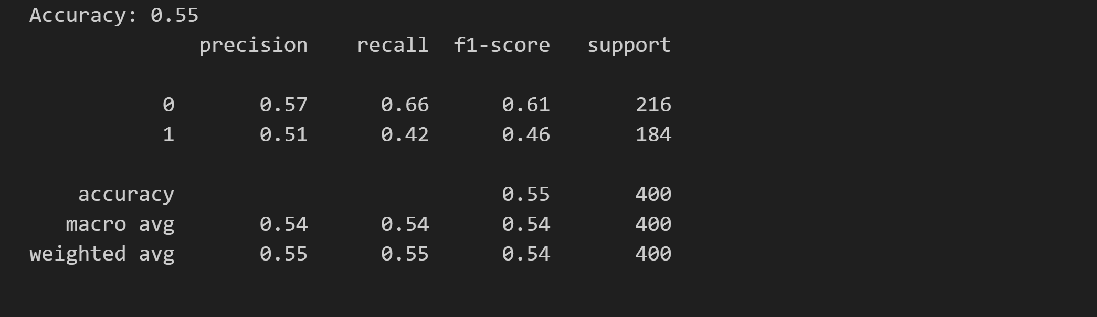
Results
Confusion Matrix for Logistic Regression Model

Slide 14
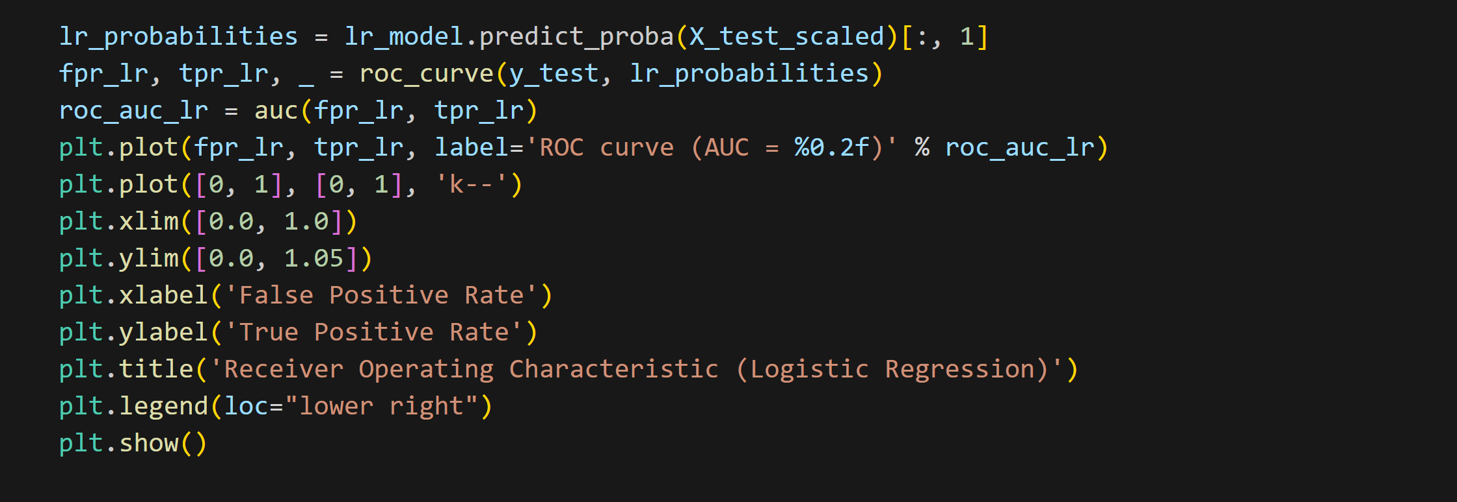
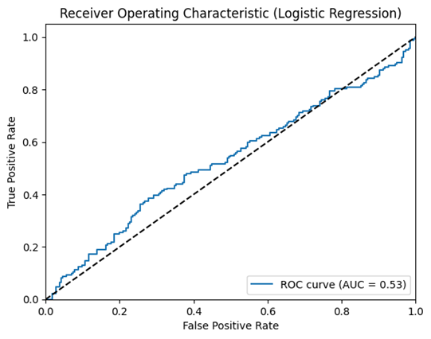
ROC Curve for Logistic Regression Model

Slide 15
Model – k-neighbors classifier
A non-parametric classification algorithm called K-nearest neighbors (KNN) uses the majority class of its closest neighbors to determine the class of a given data point. Since it doesn't make any assumptions about the distribution of the underlying data it works especially well with datasets that have intricate decision boundaries. KNN is capable of efficiently classifying new instances by taking into account the classes of the closest data points. Because of its adaptability to different problem domains and data types it is a versatile tool for classification tasks. Because of its ease of use and efficiency KNN is a useful choice in situations where the data's structure is unclear or where more conventional parametric approaches might not be appropriate.

Slide 16
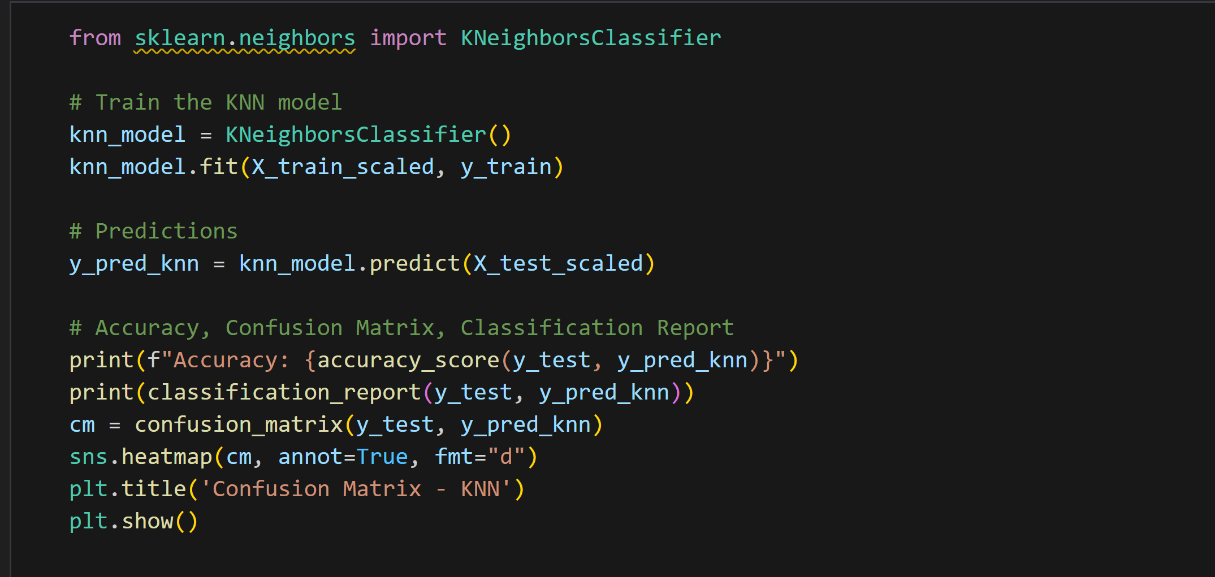
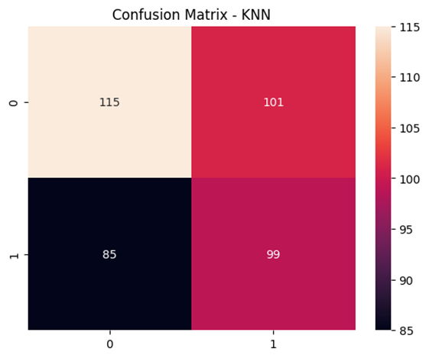
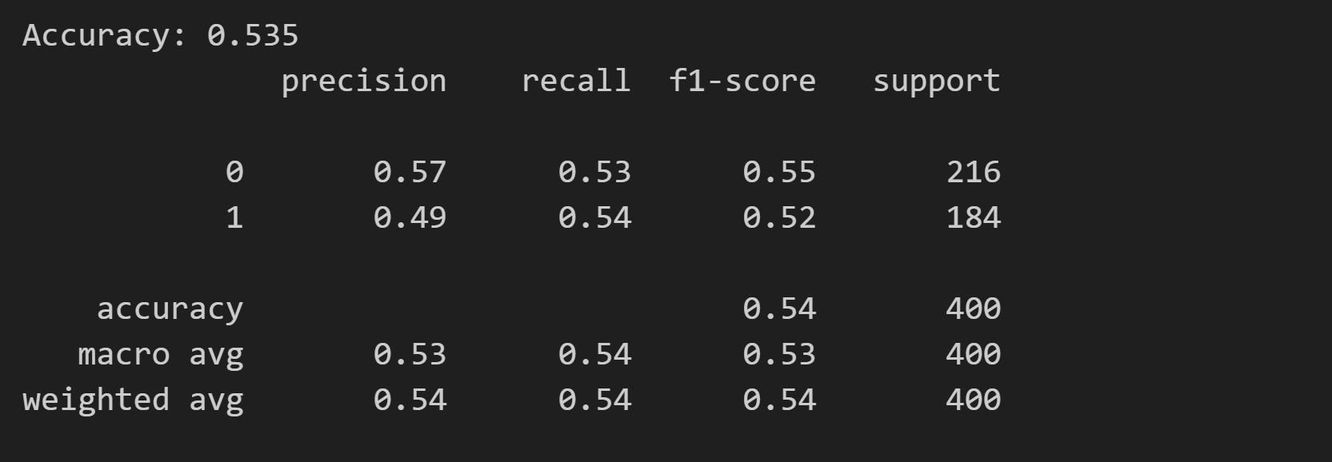
Results
Confusion Matrix for K-Nearest Neighbors (KNN) Classification Model

Slide 17
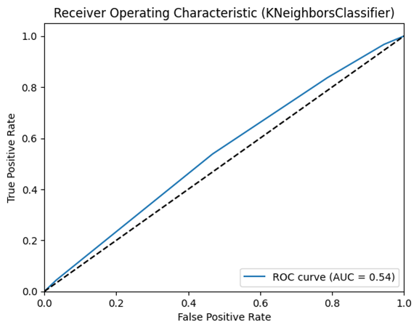
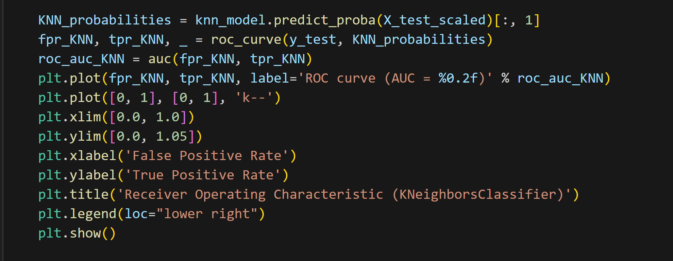
Receiver Operating Characteristic (ROC) Curve for K-Nearest Neighbors (KNN) Classification Model

Slide 18
Model – Random Forest Classifier
As part of an ensemble learning process Random Forest builds several decision trees during training and aggregates the predictions from each to generate a final result. The final prediction is obtained by taking the mode (in classification) or averaging (in regression) the predictions from each individual decision tree in the forest each of which is trained using a random subset of the training data and features. This method enhances the model's generalization capabilities and reduces overfitting. Because Random Forest can capture non-linearities and interactions well it is especially useful for handling high-dimensional data and complex relationships between variables. Regression and classification are two common machine learning tasks that use it because of its robustness and resistance to noise in the data which allow for the accurate prediction of essentials.

Slide 19
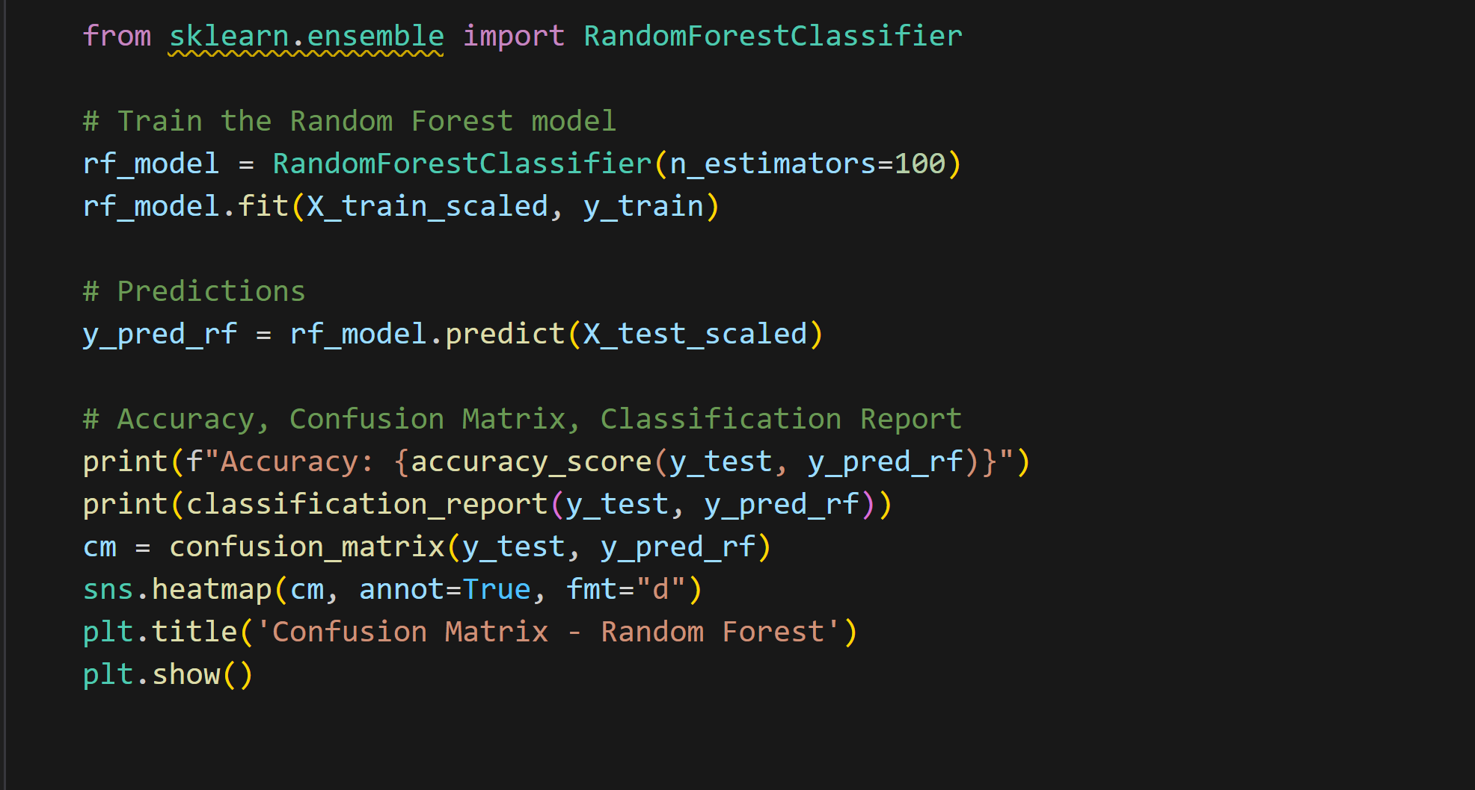
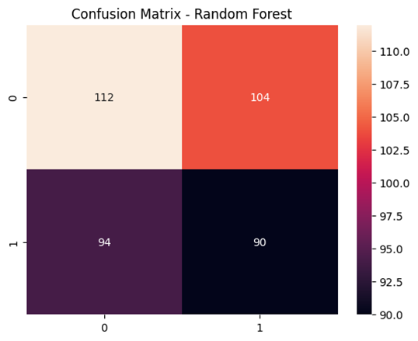
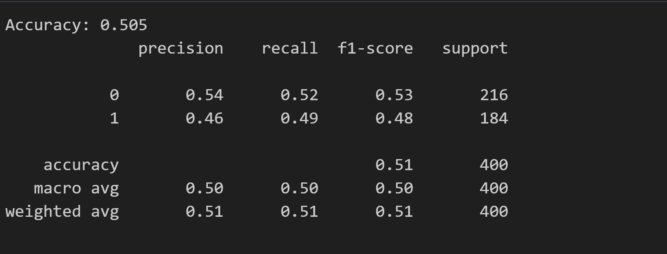
Results
Confusion Matrix for Random Forest Classification Model

Slide 20
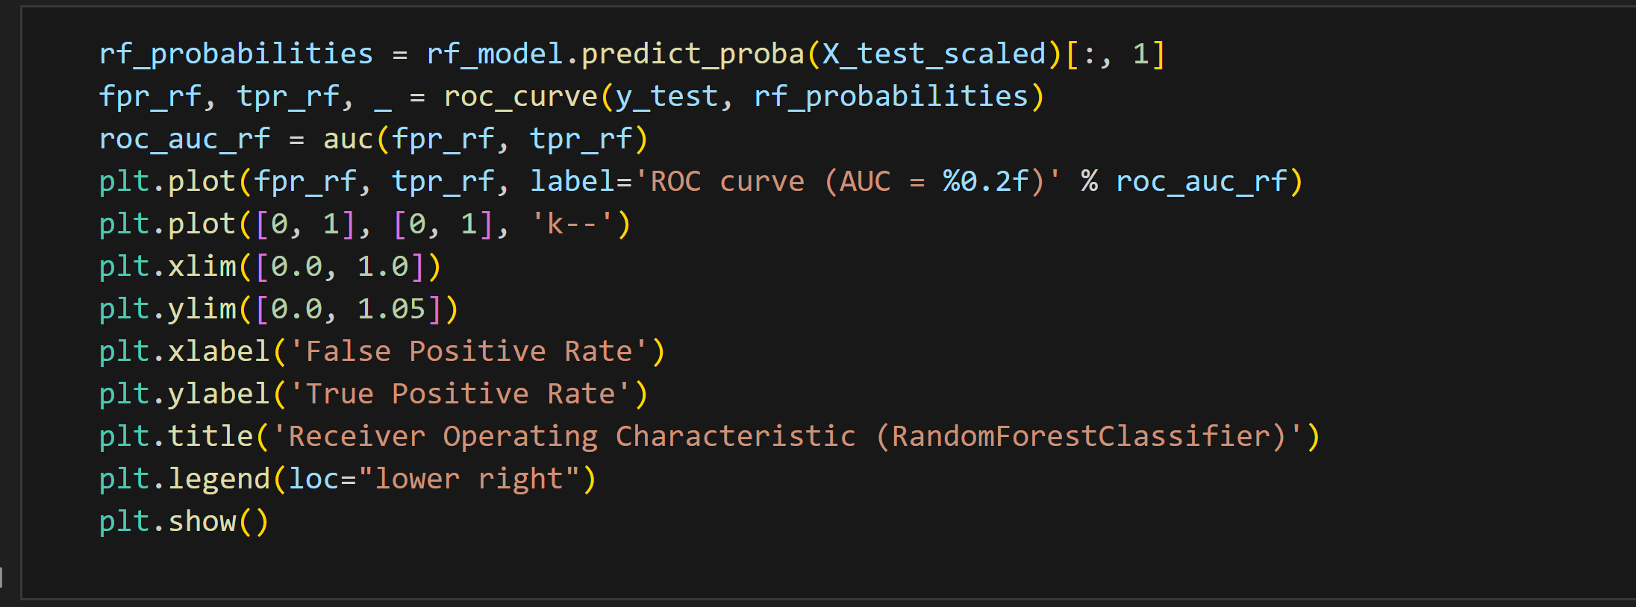
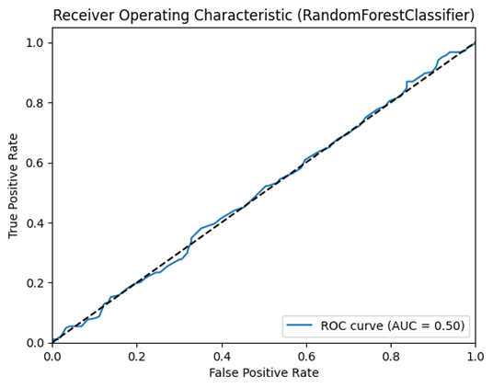
ROC Curve Analysis for Random Forest Classification Model

Slide 21
Key Findings
The percentage variable showed a bimodal distribution with two peaks in the exploratory data analysis suggesting that there may be two different student groups. Academic subject scores showed patterns and correlations that were both strong and weak according to the researchers. According to the box plots, students who are in need of financial assistance typically have lower percentage values than students who do not. All grade levels show that there are more male students than female students according to the stacked histograms illustrating the gender distribution. There are fewer students in each grade level who have financial need than there are students who do not, according to the distribution of students across grade levels based on their financial need status.
Random forest, K-nearest neighbors, and logistic regression were the machine learning models employed in the project. The models' performance was assessed using AUC-ROC, precision, recall and confusion matrices as evaluation metrics. According to the results the Random Forest model outperformed all other classifiers in terms of predicting scholarship eligibility with logistic regression coming in second. K-nearest neighbors fared the worst.

Slide 22
Conclusion
In conclusion the project on predicting scholarship eligibility offers valuable insights into the application of various machine learning algorithms and exploratory data analysis in creating models that can pinpoint the variables affecting the prediction of scholarship eligibility. The project's findings highlight the crucial role that machine learning plays in education and show the promise of data-driven approaches in predicting scholarship eligibility. Research on predictive analytics and data-driven research, as well as additional funding will continue to shape solutions that can enhance students' lives.

Slide 23

Thank you

